Slide 1

Online Based Digital Revolution
Online Live Shops (Market and Delivery)
www.srclbd.com

Slide 2
Online Live Shops
Why Go for Online Market……..?
www.srclbd.com

Slide 3
01
Present Demand
03
Customers Choice
According to e-CAB, The outreach of the e-commerce business market exceeded Tk 17.0 billion in 2017 from Tk 4.0 billion in 2016, and expected to equal Tk 70 billion by 2023.
A Google research paper titled “Research Insight: Emerging Trend as Bangladesh goes Digital” found that 22% of the countries total Internet users shop online and spend Tk 7594.10 annually on an average.
E-COMMERCE
INTERNET SHOPPING
02
COVID-19 Effect
04
Available Fund
Business dimension is changing as new innovation hits the market. Online transactions booming for purchase on safety grounds. Grocery, essentials and medicine delivery growing at 300%.
PM has announced an incentive package of Tk20,000 crore as working capital to overcome the possible impact on SMEs including e-commerce industries due to the outbreak of the novel coronavirus.
05
Public Engagement
At present, this sector comprises over 40,000 individuals and more than 30,000 SMEs along with hundreds of entrepreneurial organizations
www.srclbd.com

Slide 4
Timeline Style
2000
2009
2013
2016
The e-Commerce sector has seen dramatic growth worldwide since the early 2000’s.
Bangladesh Bank, the country’s central bank authority, began permitting online transactions.
Bangladesh Bank also permitted the purchase and sale of goods and services online using international credit cards.
In the first three quarters of the year, the e-commerce industry achieved 67 per cent growth whereas, the country's e-commerce transaction reached BDT 3.59 billion.
According to market analysts, Bangladesh's e-commerce business market will reach USD 20 billion by the end of the year.
Bangladesh ranked 103rd in UNCTAD's Business-to-Consumer (B2C) E-commerce Index
The number of e-commerce business sites and e-commerce pages equaled 2,500 and 150,000 respectively.
According to ITU, the number of internet users has nearly tripled from 6.5 percent in 2013 to 18.2 percent in 2017 of the population.
2020
2019
2018
2017
www.srclbd.com
www.srclbd.com

Slide 5
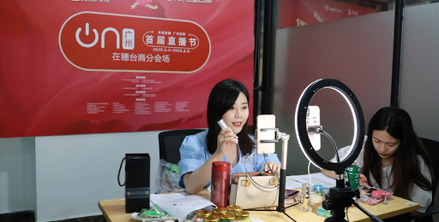
E-Commerce Trends Worldwide
According to data from Statista, by the end of 2020 the global ecommerce market sales will reach $4.2 trillion and make up 16% of total retail sales.
Asia is responsible for almost a half of the global mobile commerce market. China, UAE, & Turkey have the highest number of mobile shoppers, with 68%, 57%, and 53% respectively of the total population.
Gartner predicts that, by 2021 over 80 percent of all customer interactions will ne handled by AI.
By 2021, early adopter brands that redesign their websites to support visual and voice search will increase digital commerce revenue by 30%.
8 out of 10 customers use their smartphones while shopping as in-store shopping assistants.
By 2021, B2B firms will spend more on e-commerce technology than online retailers do.
69% B2B entitles say they expect to stop printing catalogues within 5 years.
Augmented reality will generate $120 billion in revenue by 2021.
In 2021, over 2.14 billion people worldwide are expected to buy goods and services online, up from 1.66 billion global digital buyers in 2016.
FACEBOOK
TWITTER
According to an analysis, the stores that have at least one social account (Facebook and/or Twitter) have 32% more sales on average than stores that don’t use Facebook and/or Twitter.
Of the e-commerce sites that have a Facebook account, 60% are also using Twitter.
www.srclbd.com

Slide 6
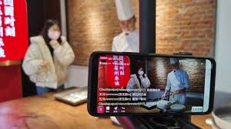
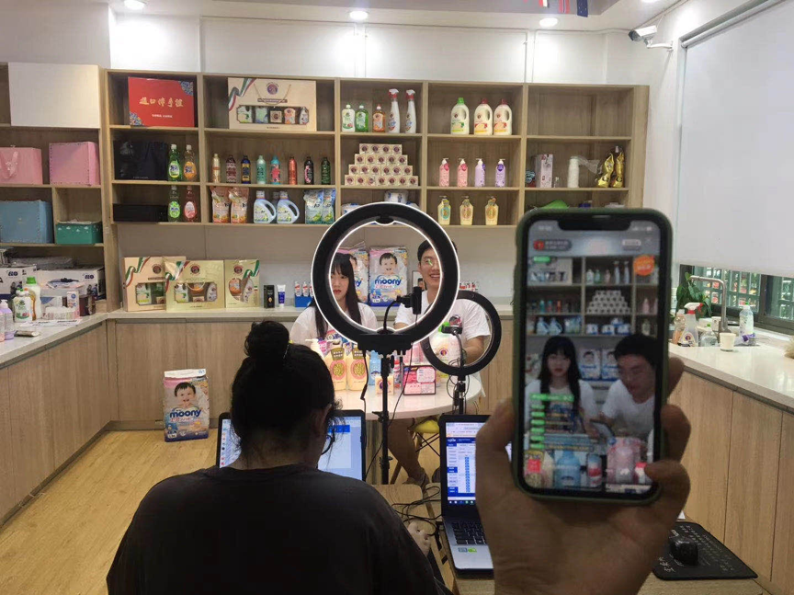
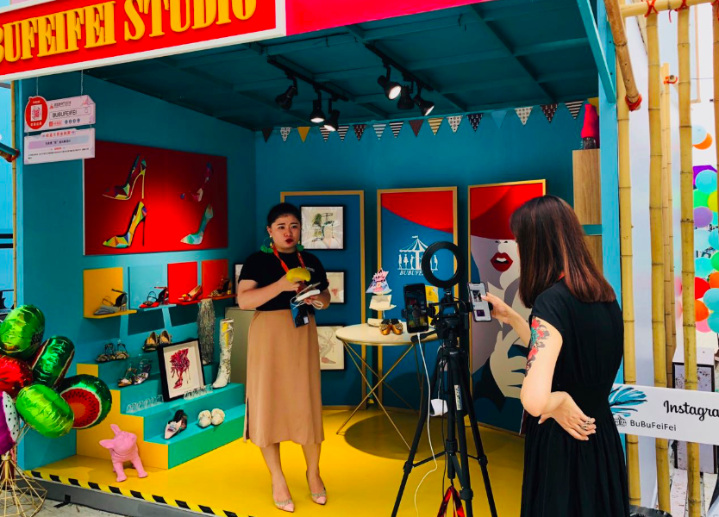
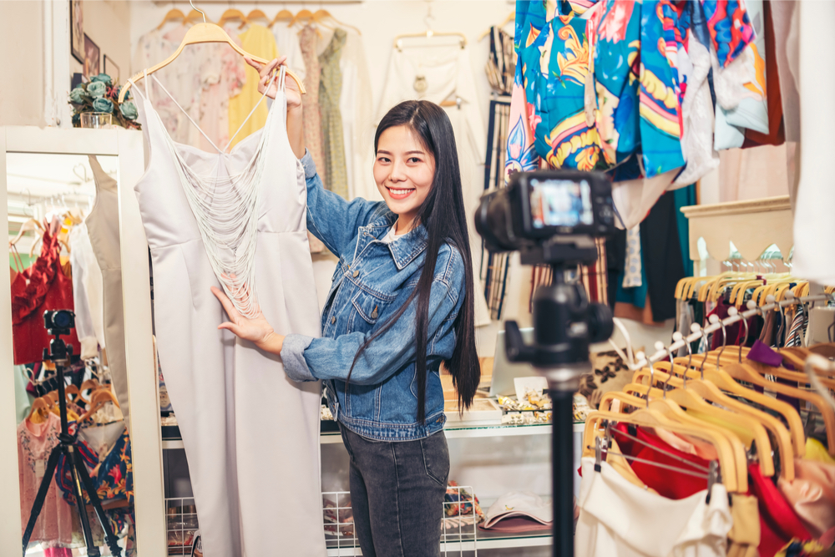
Online Business Scenario
E-COMMERCE
www.srclbd.com

Slide 7
OUR INPUT
Shop Keepers
Customers
www.srclbd.com

Slide 8
Facts & Figures of E-Commerce
The B2C E-commerce business market in 2017, against the 133,571 crores total retail market.
900 crore
According to the e-Commerce Association of Bangladesh (e-CAB), the market measure is relied upon to reach by 2021.
70 billion
35,000
Number of individuals involved in this sector.
20,000
The quantity of delivery is assessed at 15,000 to 20,000 at the retail level every day.
Small and Medium Enterprises (SME) engaged with e-commerce business.
25,000
www.srclbd.com

Slide 9
Online Shop Design
Our Services
Online Setup
Installation of an affordable and sustainable online platform equipped with ultra modern technologies.
E-Commerce Platform
Development of a user-friendly e-commerce platform for all types of business activities.
Product Delivery
A custom-built smooth and fastest product delivery system.
Payment Gateway
A highly secured, encrypted, and simplified online payment system.
www.srclbd.com

Slide 10
Places of Involvement
1
Mega Shopping Mall
Bashundhara City, Jamuna Future Park etc.
2
Wholesale Market
Islampur, Gulistan Wholesale Market etc.
3
Retail Market
Kawran Bazar, New Market, Mouchak market etc.
4
Restaurant
Star Kabab, Baton Rouge, Fish & Co. etc.
5
Fashion House
Zara, Lubnann, Diamond World etc.
6
Kacha Bazar
Kawran Bazar, New Market etc.
www.srclbd.com

Slide 11
E-COMMERCE
Funding sources
01
Government Entity
Ministry of Commerce, Information & Communication Technology Division etc.
02
Financial Institution (Bank / Non-Bank)
SOBs, PCBs, FCBs, NBFIs etc.
03
Donor & NGO (Local / Int.)
World Bank, ADB, USAID, Solidaridad, Swisscontact etc.
04
Individual Shop Owner
Dhanshi, Eco-Style, Green Mart, Water Lotus etc.
www.srclbd.com

Slide 12
Benefits of Association
Financial
Bank loan, Foreign donation etc.
01
Online Shop
They will get an online shop that will gradually reduce their costs of maintaining an offline shop.
02
Sales & Delivery System
One sales & delivery system will be developed all over Bangladesh.
03
04
Profit Share from Donor fund
After the completion of the project they will get a percentage of profit.
www.srclbd.com

Slide 13

Profit
Future Market
Loss
People are engaged online marketing everyday and become habituated to buy products staying home which leads to BDT 70 billion e-commerce market opportunities by 2021.
BDT 4 billion Profit
Due to the corona pandemic, people expend nearly 400 million to buy products online which could be a great opportunity for the offline shops if transformed into online.
BDT 4 billion Loss
Offline market lost approximately BDT 400 million in the first 8 months of this year due to coronavirus.
www.srclbd.com

Slide 14
Scenario 2025
Present
2025
85%
85%
Direct Market Shopping
Online Shopping
70%
70%
Direct Retail Shop Mall
Direct Purchase on Virtual Shop
65%
50%
Direct Kacha & Wholesale Bazar Shopping
Direct Kacha & Wholesale Bazar Shopping
50%
55%
Direct Purchase by the customers
Direct Retail Shop Mall
32%
42%
Online Shopping
Direct Market Shopping
www.srclbd.com

Slide 15
Online Shop Decoration Technology
Web Camera (1080p) for high resolution videos
Sound System for student communication
42’ LED TV monitoring Screen for student Monitoring
Moveable Camera Stands,
Whiteboard, marker and multiplug
USB Hub and customized Connector
Audio Card USB Connected,
Video Recording and class live equipment (1 Set)
Boya for clear voice communication
Bluetooth Mouse and key board
HDMI Cable (10 Meters)
Internet stabilizers
Voltage stabilizers
Broadband connection with LAN facilities
Projector with multimedia
Super soft lighting for clear class
Moveable stand table
YouTube Channel for every school
Facebook group
Online server for every classroom
Online classroom facilities from Google
Laptop or Desktop
www.srclbd.com

Slide 16
Different Training Services
Business Training Service
Online Business Operation
Online Sales
Online Marketing
Corporate Sales
Mobile App Media Sales
Outdoor Sales
Bank Loan Documentation Management
Online Accounts Management
Social Training Services
COVID-19 Safety
Fire Safety
Fire Equipment Installation & Maintenance
Customer Behavior
Sales Motivation
WASH Management
Environment & Energy Savings
www.srclbd.com

Slide 17
Team
Online Business Expert
Project Management Expert
Skilled
IT
Professional
Express Delivery Lineup
Have four specialist who are knowledgeable and experienced with trending online business activities.
Have five highly qualified and certified Project Management professional
Have six idealistic and innovative Information Technologist with professional certificate.
Have some dynamic, hard-working and dedicated members with up to date delivery skills.
www.srclbd.com

Slide 18












Present Clients
www.srclbd.com

Slide 19
Packages
Basic
Standard
Smart
Ultra
Advance
Retail shoppers
Restaurant Business
Shopping Malls
Fashion House
International Entities
www.srclbd.com

Slide 20
Donors in SME sector
International
National
World Bank
GOB
ADB
Planning Commission
JICA
ICT Department
Oxfam
LGED
Swisscontact
SME Foundation
USAID
PKSF
GIZ
Bangladesh Bank
Solidaridad
IDE

Slide 21
Market Size
Description:
The Target Market: Wholesale market, Retail market, Shopping malls, Fashion house, Daily shops, Restaurant etc.
The Total Market Size : Around 50,000 + Wholesale market, Retail market, Shopping malls, Fashion house, Daily shops, Restaurant are eligible for this project in Bangladesh
The Market Share that the Company will Target: 15%-20% of Total Market
www.srclbd.com

Slide 22
Collaboration with BDMS
Memorandum of Understanding
Mutual Contract with Bangladesh Dokan Malik Somity (BDMS)
Fund Raising Activities
Application
Project Proposal Submission
Presentation
Fund Raising
Project Management Activities
Online Shop
Project Starting
Training
Shop Installation
Documentation
Problem Troubleshooting
Project Monitoring & Evaluation
www.srclbd.com

Slide 23
Step by Step Activities
Profit Share
Project Implementation
A MoU will be signed by both the parties upon agreed.
Fund Raise
A proposal will be sent by SRCL to the interested person or institution.
Upon successful implementation of the project, the profit will be shared between both the parties according to the signed MoU.
MoU
Upon receiving the project fund SRCL will coordinate the whole activities regarding the implementation of the project.
Proposal
SRCL will move for fund raising activities.
www.srclbd.com

Slide 24
THANK YOU
www.srclbd.com

